Slide 1
Review => Motivating Privacy-Enhancing Protocols
Amar Singh

Slide 2
Roadmap
Proof of Work Review
Radical Markets (Economics)
Quadratic Voting
Harberger Tax => Common Ownership Self-Assessment Tax
Liberal Radicalism
Layer 2 Scaling Solutions (and security assumptions)
Proof of Stake
Ethereum 2.0 ⇔ Serenity
Polkadot
Privacy

Slide 3
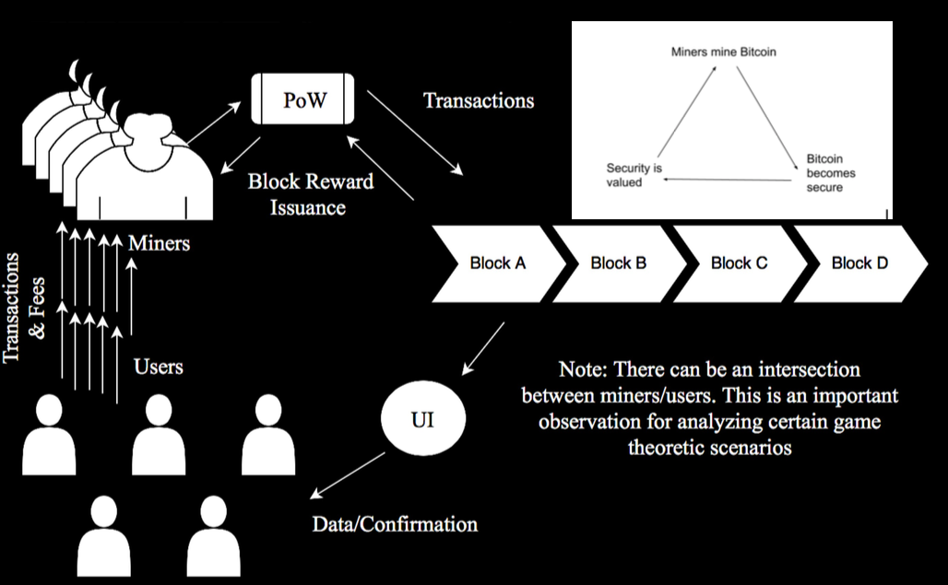

Slide 4
Proof of Work Consensus Algorithm
1.. The nodes compete with each other to decide who gets to verify this block of transactions.
the competition consists of hashing the block of transaction data along with some random number so that the output string fulfills some requirement; more specifically, it needs to have a certain number of leading zeros
The hashed output is called the proof-of-work and has the characteristics of being difficult to compute and impossible to fake.
2. The proof-of-work is published to the network along with the block of transactions and nonce so that anyone can check that it is indeed a valid proof-of-work
3. The validated block is added to the blockchain, which is a chain of the entire history of validated transactions.

Slide 5
Incentive Structuring ⇔ Cryptoeconomics
“Cryptoeconomics is an area combining together ideas from cryptography, game theory, fault tolerance and decentralization in order to build systems that have security properties that any one of those things alone can't provide.”
Vitalik Buterin

Slide 6
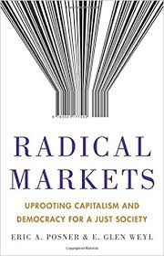

Slide 7
Quadratic Voting
→ Majority Rule does not achieve NET SOCIAL BENEFIT
→ Weak Utilitarianism
→ QV enables group of people can use to jointly choose a collective good for themselves.
→ Each person can buy votes for or against a proposal by paying into a fund the square of the number of votes that he or she buys.
→ WHY QUADRATIC?

Slide 8
Harberger Tax => COST
Continuous Auction
Allocative Efficiency vs. Investment Efficiency
Tax on Illiquidity
Use Cases
How can we make it better?

Slide 9
Liberal Radicalism
→ public fund matching mechanism (proportional to number of individuals that vote for a cause)
→ identity is assumed as well as a robust, trustless transaction system
Individuals make public goods contributions to projects of value to them. The amount received by the project is (proportional to) the square of the sum of the square roots of contributions received. Under the “standard model” this yields first-best public goods provision. Variations can limit the cost, help protect against collusion and aid coordination.
→ How does this incentivize coordination? Collusion risks?
→ Funding this with Harberger Taxes
→ Related Projects and People
→ SimonDLR and NFTs
→ Harberger Taxes Ad Board Implementation for ETHSF

Slide 10
Scaling with State Channels

Slide 11
State Channels
Multisig
Two users lock the initial state (each party’s balance) into a multisig
Two parties transact by passing state updates amongst themselves
When parties have finished transacting, they each submit state updates to the smart contract
→ Challenge Period
-->Data Availability Problem
→ Tree in Forest Analogy
→ Speaker/Listener Fault Equivalence

Slide 12
Micropayment Subscription Model
→ Review

Slide 13
Ethereum 2.0 Serenity
Proof of Stake
Sharding
Draw bootstrap on blackboard
Transition to targeting EWASM
Transition to Libp2p Network Layer

Slide 14
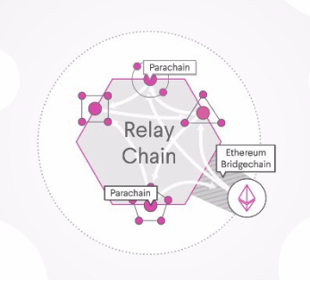
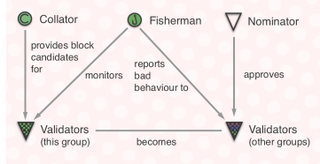
Polkadot: Heterogeneous Sharding

Slide 15
MakerDAO and/or Privacy
ZCash and Josh Cincinatti

